Slide 3
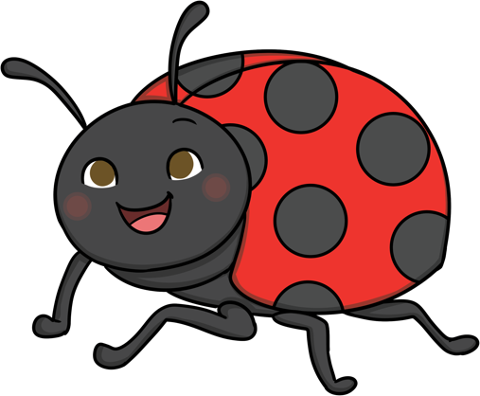
Ladybird
They use their antennae to
taste and smell.
It is a small flying beetle.
They have six
legs and an oval-
shaped body.
They are usually
red but can also
be yellow, orange,
brown, pink and black.

Slide 4
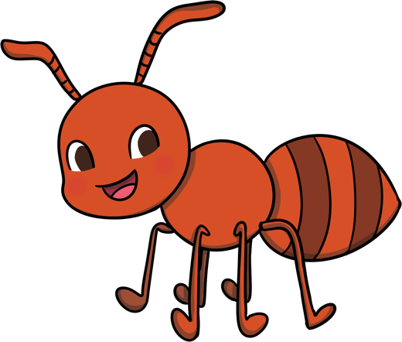
Ant
They don’t have ears.
Most ants are red
or black.
An ant can lift
20 times its own body weight.
They like to live
in big groups called
a colony.

Slide 5
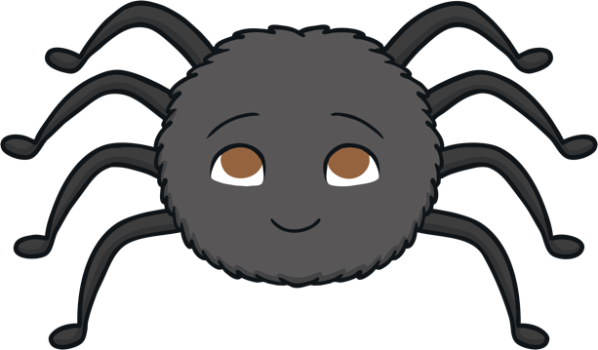
Spider
Spiders are called arachnids.
A spider has eight legs.
They eat flies
and other
small insects.
The largest spider
in the world is a tarantula.

Slide 6
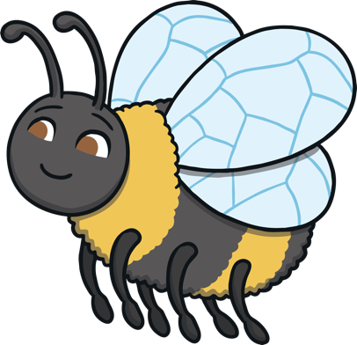
Bee
Bees are flying insects.
Their home is
called a hive.
Bees have yellow
and black striped bodies.
Bees mainly eat the
nectar and pollen from flowers to make honey.

Slide 7
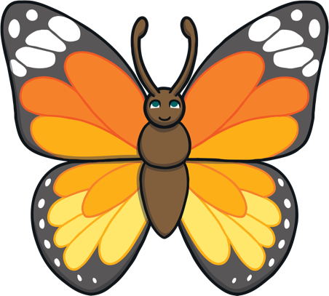
Butterfly
They have four wings.
There are four
stages in the life
cycle of a butterfly:
egg
caterpillar
chrysalis
butterfly
A butterfly uses its
front feet to taste.

Slide 8
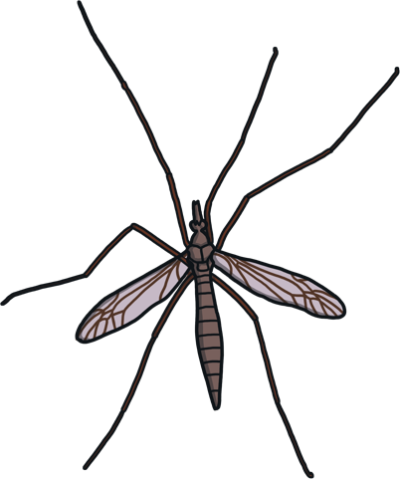
Crane Fly
Baby crane flies are
called larvae.
They like eating
rotten wood
and grass.
A crane fly
only lives for
10-15 days.
A crane fly is also
called a daddy-long-legs.

Slide 9
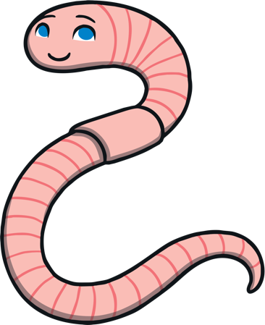
Worm
A worm does not
have any bones.
They breathe through
their skin.
Worms are long
and thin and live underground.
Worms can eat from
half their weight to
their full weight in food each day.

Slide 10
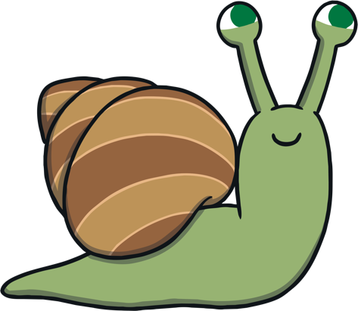
Snail
Its tongue has rows
and rows of tiny
teeth on it!
When it walks, it
leaves a silvery
trail behind it.
When a snail
is frightened, it
hides in its shell.
A snail has four
tentacles, two for
its eyes and two
for feeling for food.

Slide 11
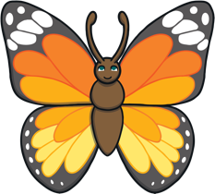
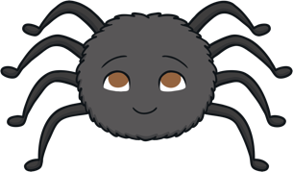
Minibeast Challenge
Now see if you can do the Minibeast Challenge! Can you guess which minibeast is being described? Click on which minibeast you think it is.
It has eight legs.
They are often called arachnids.
They like to eat flies.

