Slide 1
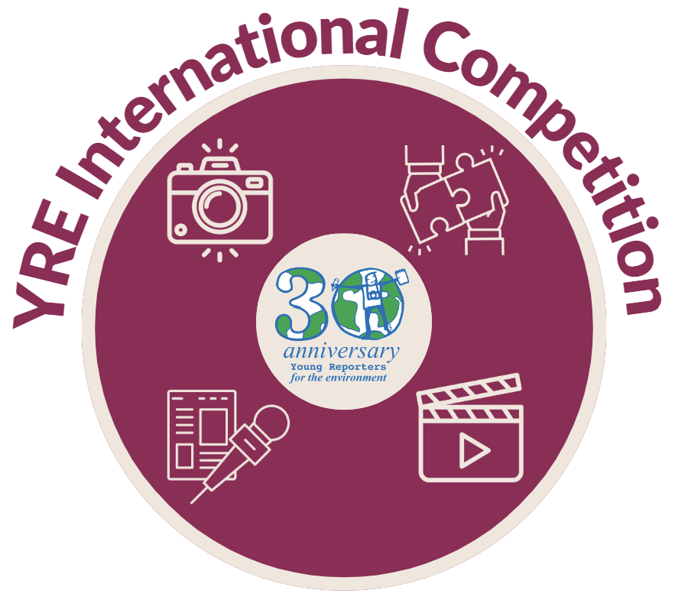
YOUNG REPORTERS FOR THE ENVIRONMENT
Notes:
Add ROoT logo

Slide 2
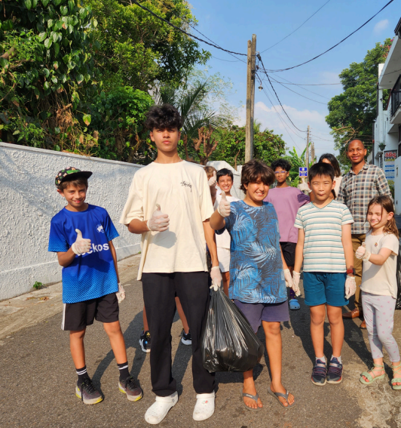
Tired and bored of negative
environmental news!?
The Young Reporters for the Environment (YRE) programme allows young people to become solution-oriented leaders through the YRE International Competition!
Young Reporters for the Environment holds an annual International Competition for young people aged 11-25 involved in the programme.
The purpose of the competition is for young people to investigate environmental issues, propose solutions, report it through various communication and journalistic ways to a local network and raise awareness by sharing it with an international community.
‘Young Geckos Cleaning Streets for a Clearer Future’
1st place YRE International Competition 2023-2024 - Article Category 11-14 years old

Slide 3
The 4 steps to take part in YRE

Slide 4
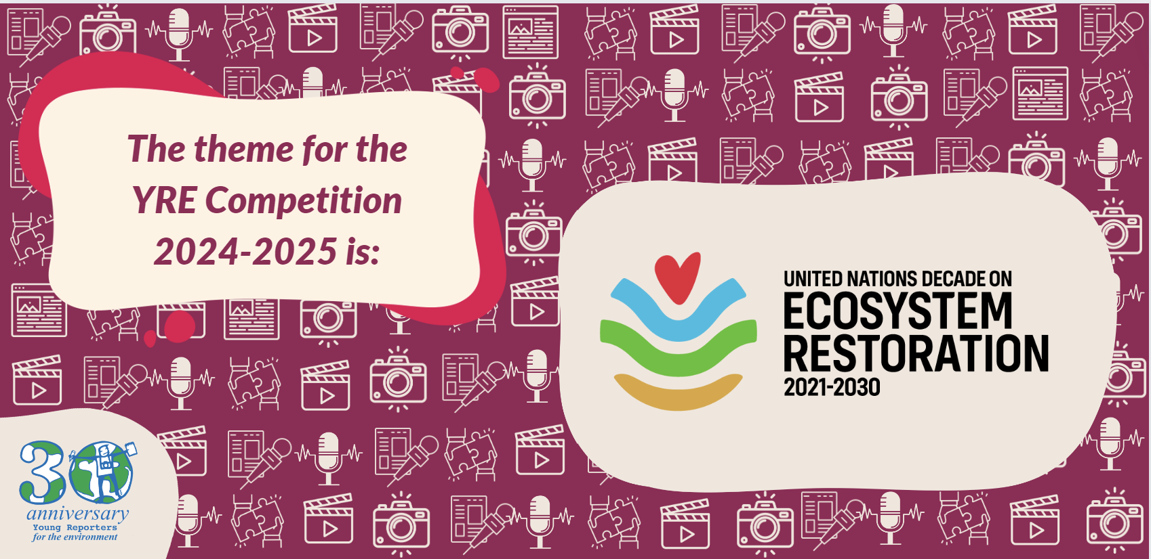

Slide 5
Competition Categories: Photos
The purpose of the One Take Photo is to tell a story through a photograph that truthfully and accurately captures the reality of an environmental situation, event, or issue at one point in time.
The photograph should not be AI generated, posed or manipulated.
The purpose of Staged Campaign Photo is to raise awareness of an environmental issue and inspire positive action through a photograph.
There must be a clear environmental campaign message and call to action included in the photo. The photograph can be staged with the intention of sending a message to the viewers. It can be edited, include AI alterations and text.
The purpose of a Photo Story (3-5 photos) is to tell a story through a series of photographs to help the viewer better understand an environmental issue.
All photos must be original and not be AI generated, posed or manipulated.

Slide 6
Competition Categories: Videos
Long-form reporting videos are like mini documentaries or TV news reports. They are based on real environmental issues, events, history. They include elements of direct observation, research, interviews, and documentation.
Long-form reporting videos must be no longer than 3 minutes and filmed in landscape
Short-form campaign videos aim to raise awareness of an issue, promote certain values, and inspire positive action. The campaign storyline can be staged with the intention of sending a clear environmental campaign message to the viewers. Short-Form Campaign videos can take the format of Instagram Reels, Tik-Tok videos or YouTube Shorts.
Short-form campaign videos must be no longer than 1 minute and filmed in portrait.

Slide 7
Competition Categories: Podcasts and Articles
Podcasts are like mini documentaries and could take the form of audio or audio/ video. They are based on real environmental news and facts.
For the International Competition only a 5-minute segment of the full podcast needs to be submitted.
The purpose of the article category is to explore the historical, economic, social, and/ or political implications of the chosen environmental topic through a written format. The article should show the link between local and global events, issues, and/ or phenomena and include realistic solutions to the environmental issues presented.
Articles can be in the form of traditional print media, blogposts or extended Facebook Posts
Max. 1,000 words.

Slide 8
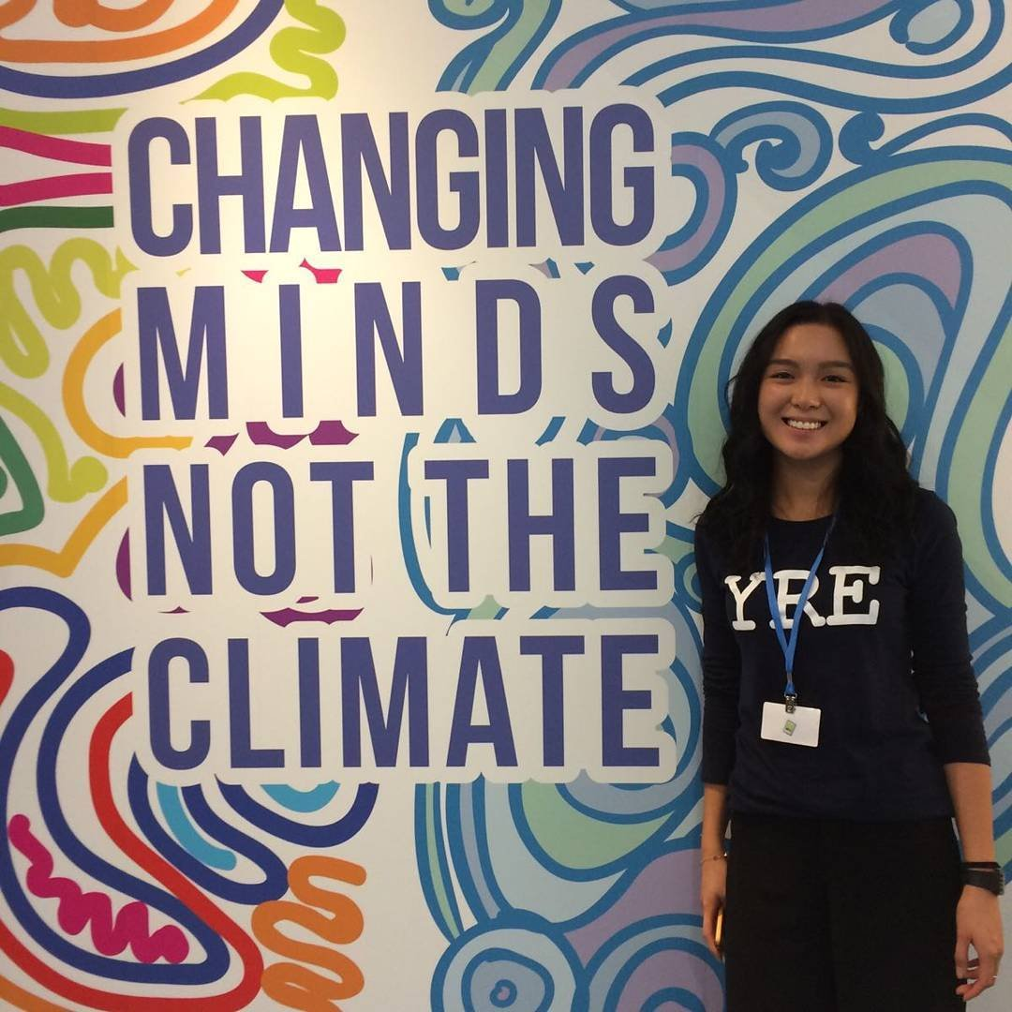
Deadlines and Important Info
Register here to get started & to receive resources and reminders about the competition
Learn more about the criteria for each category:
Article
Photo
Video
Podcast
Get inspired with examples of previous winners of the Young Reporters for the Environment competition
The Final Deadline to submit work is Friday, 2nd May 2025
Contact eco-schools@keepnorthernirelandbeautiful.org or michelle.gallagher@keepnorthernirelandbeautiful.org if you have any questions!

Slide 9
FIND OUT MORE
VIEW PREVIOUS YRE INTERNATIONAL COMPETITION WINNERS
https://www.yre.global/
Notes:
Add ROoT logo

