Slide 1
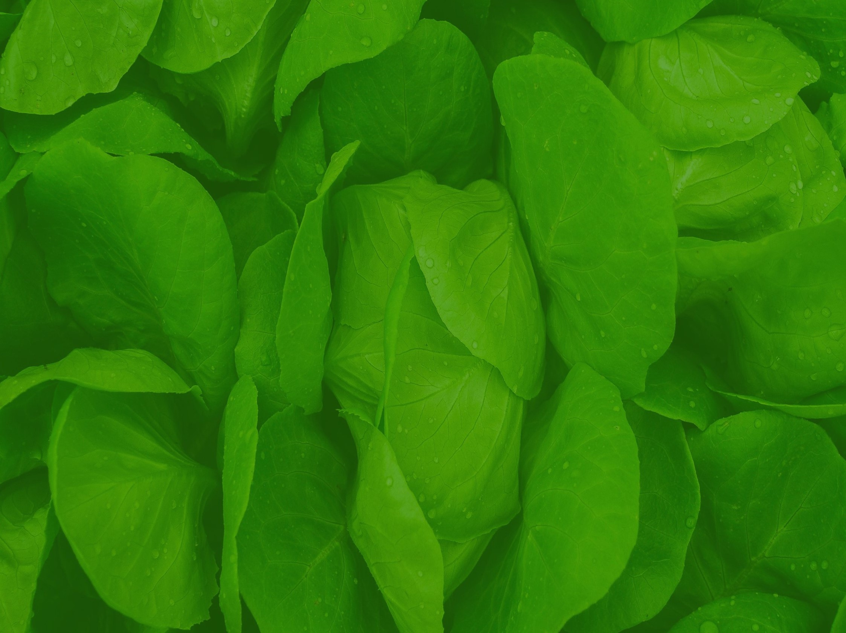
Spring Fruit and Vegetable Growing

Slide 2
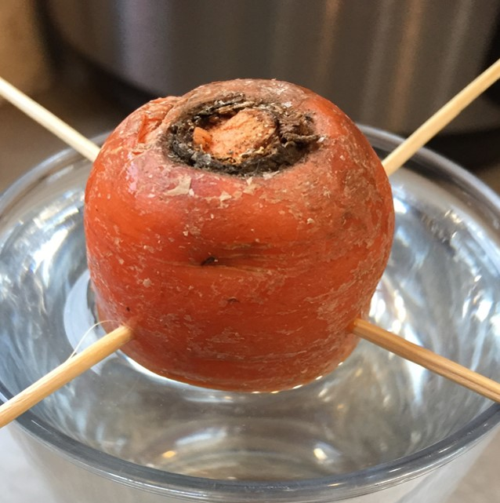
Growing Carrot Tops
Please note: this will not grow the carrot root, only the carrot plant
Cut the top from a grocery store carrot. You’ll need about one inch (2.5 cm.) of the root
Stick a toothpick into either side of the carrot stump and balance it on top of a small glass
Fill the glass with water up to and barely touching the bottom edge of the stump
Set the glass in a light, but not sunny window
Add water to keep it touching the edge and watch the plant sprout
https://www.gardeningknowhow.com/special/children/grow-carrot-tops.htm

Slide 3
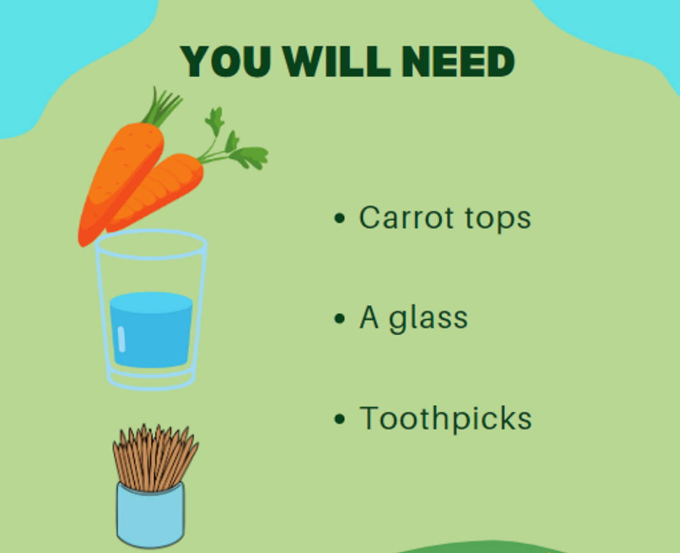
You Will Need:

Slide 4
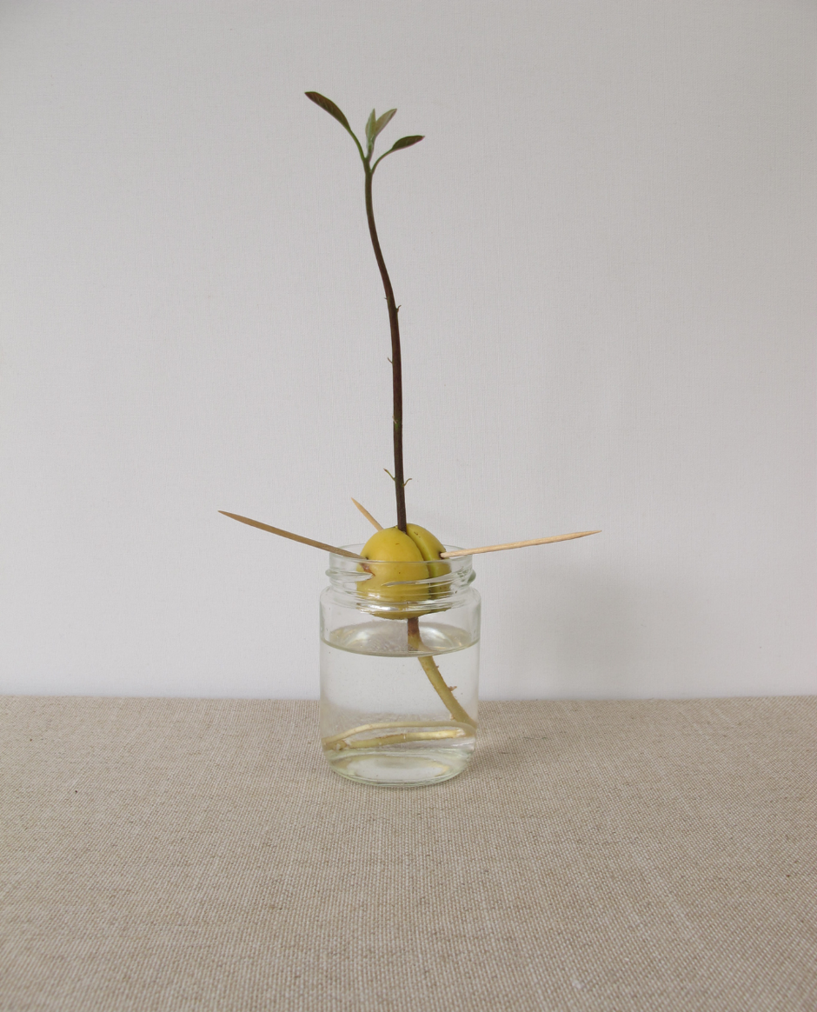
Grow your own avocado tree – water method
Wash and dry avocado pit
Use 3 toothpicks to suspend the avocado pit, broad end down, into a glass of water. Water level should cover roughly 1 inch of the pit.
Place the jar in a warm, sunny spot. Change the water every 1-2 days.
After 2-6 weeks the pit will sprout! When the stalk is 15cm tall, cut it back by half.
Plant out into soil when the stalk develops leaves.
https://www.apartmenttherapy.com/how-to-grow-avocado-plants-258836

Slide 5
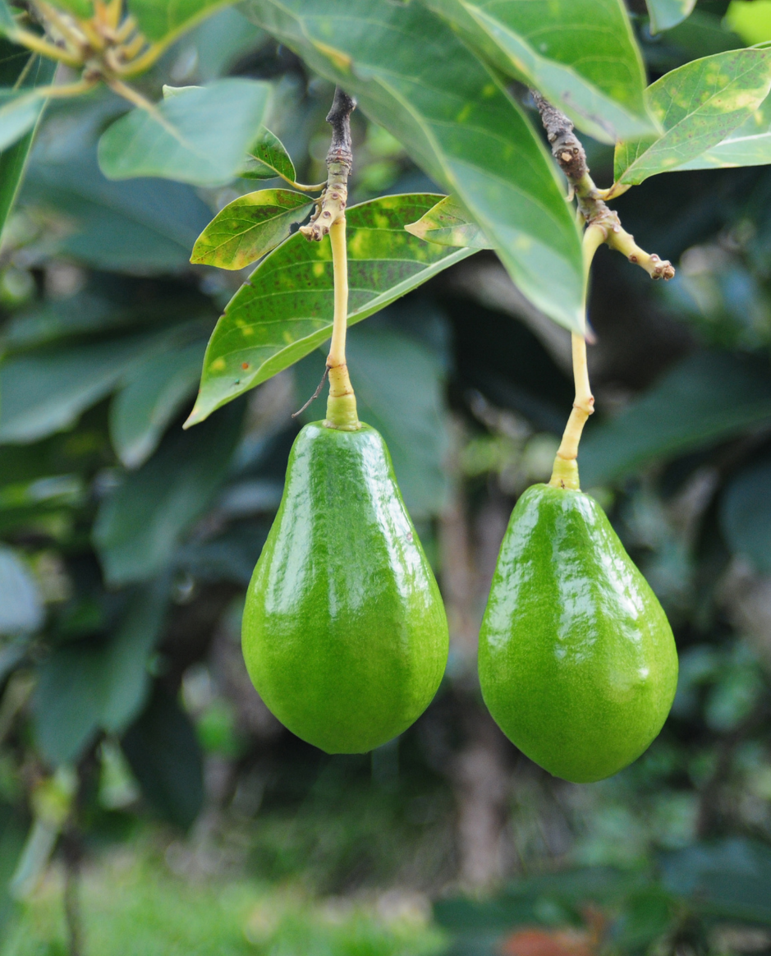
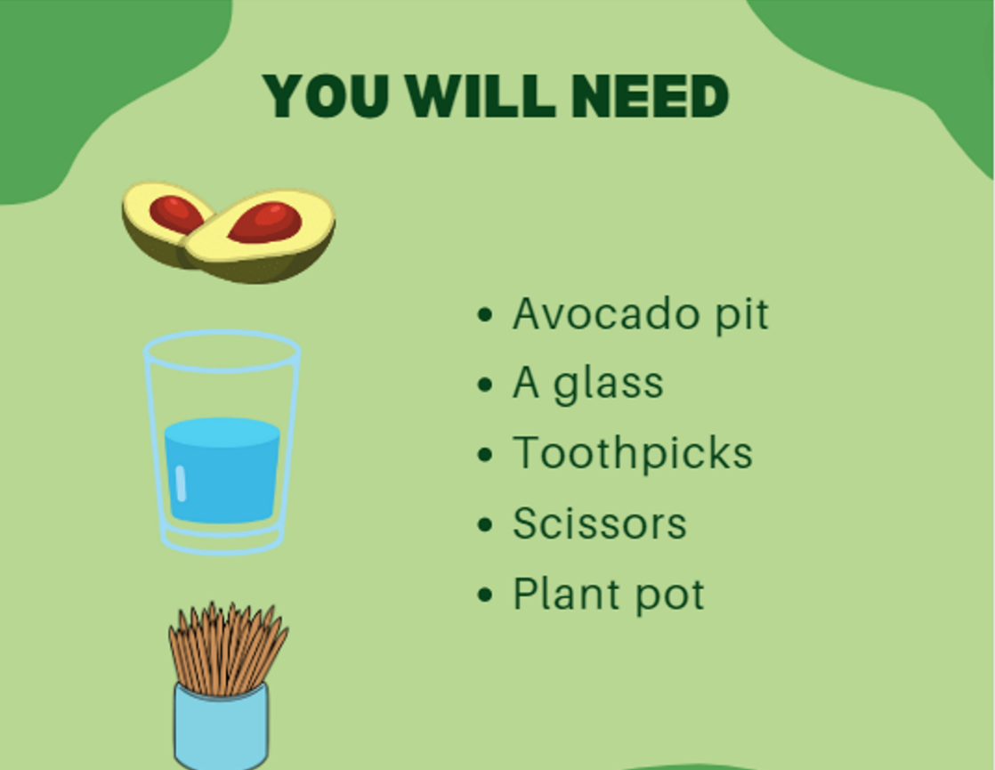
You will need:

Slide 6
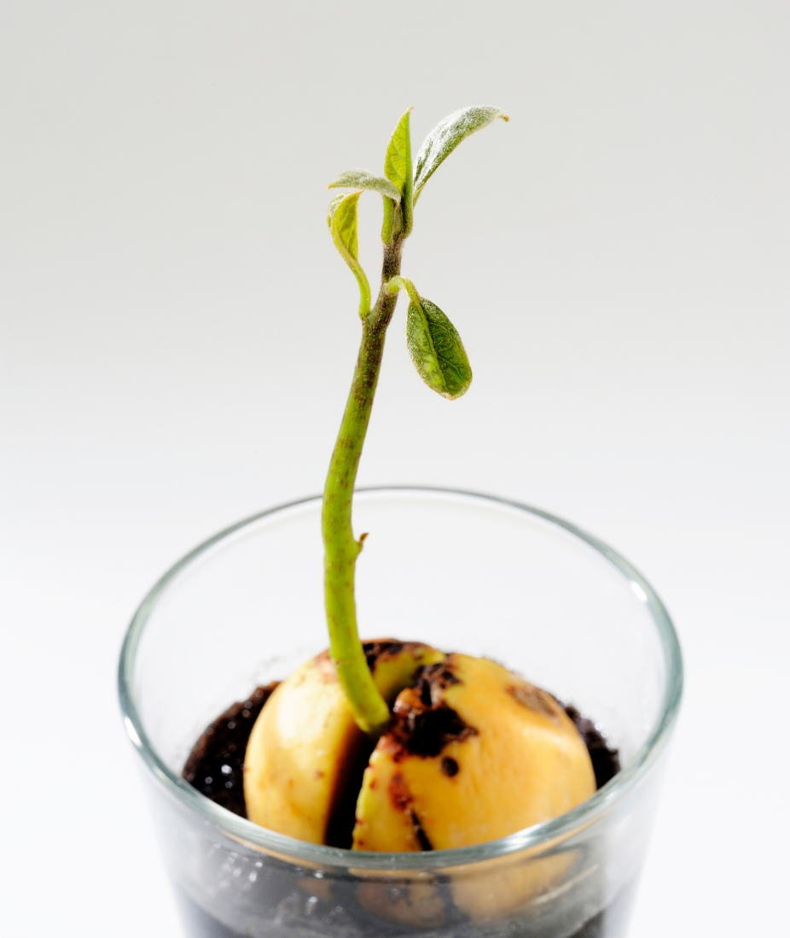
Grow your own avocado tree – soil method
Wash and dry avocado pit
Place pit (broad end first) into pot of well draining soil. Leave 1/3 of the pit exposed.
Place pot in a warm, sunny spot and water regularly.
After 5-8 weeks your avocado plant will begin to sprout! Repot the seedling into larger containers as it grows.

Slide 7
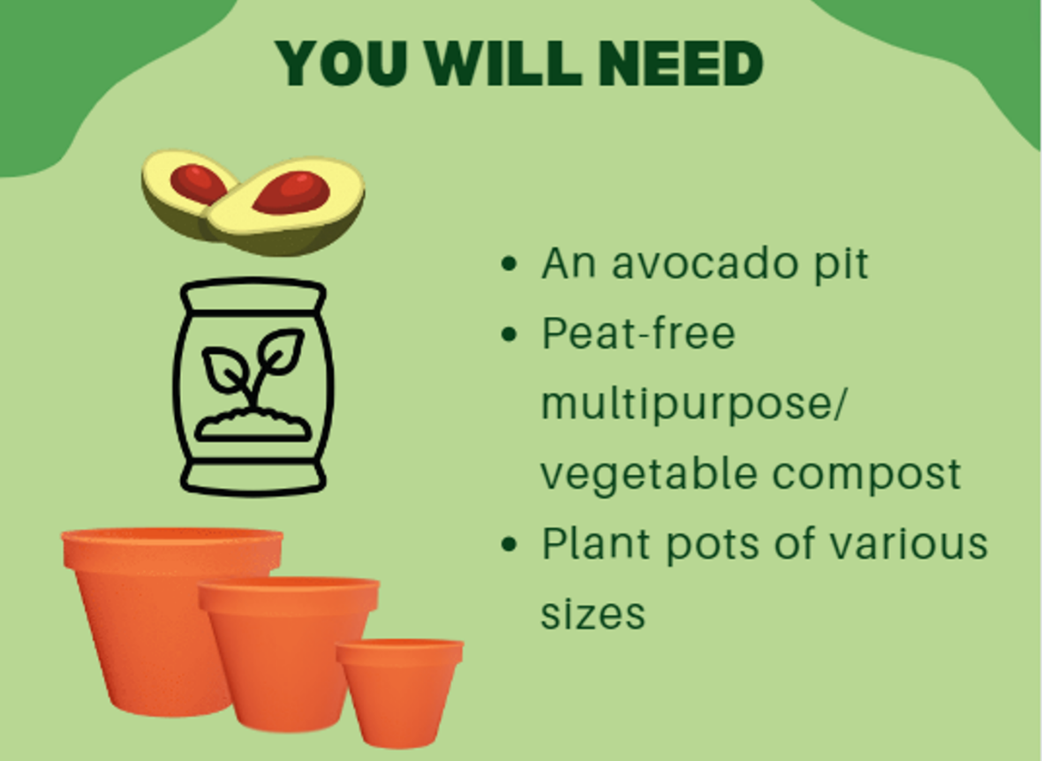
You will need:

Slide 8
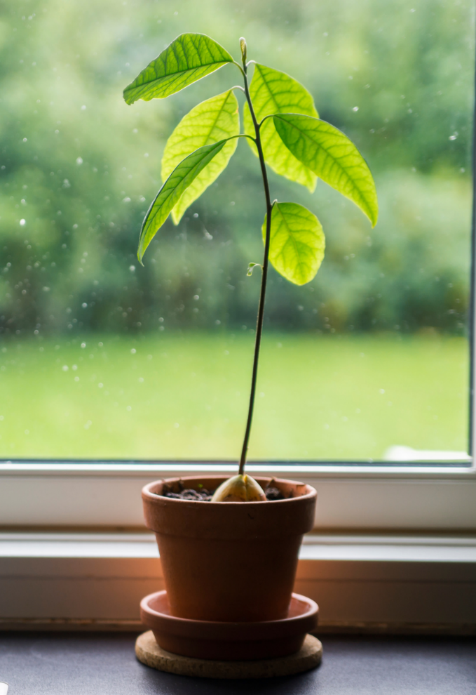
Top tips for taking care of your avocado plant
Keep your avocado plant in a warm, sunny location
Water frequently with an occasional deep soak. Keep plant moist but not overly saturated. As with most plants, make sure the soil drains well
Pinch the stem back every time your plant grows another six inches or so, in order to encourage a bushier appearance

Slide 9
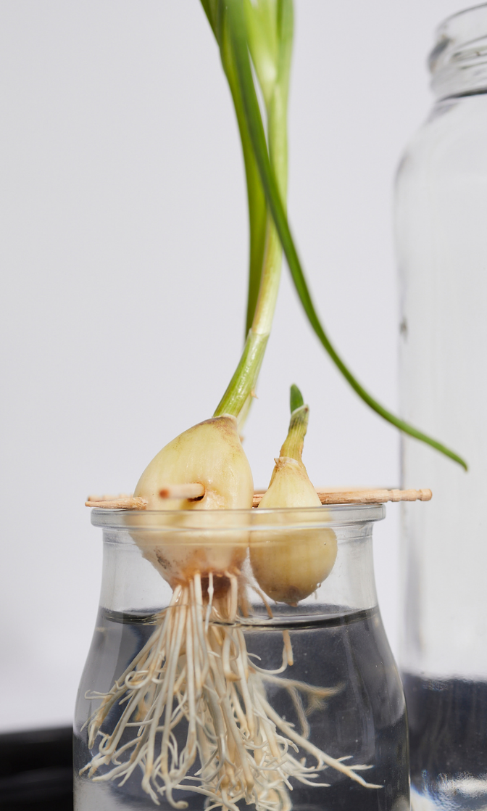
Everlasting spring onions
Cut the tops of shop-bought spring onions so they are all equal lengths.
Place in a glass of water just above the white part of the onion.
Leave in a sunny place and change the water regularly (every 1-2 days).
New shoots and roots begin growing after around 3 days - cut these green shoots off and use them for cooking!
The shoots will continue to regrow, leaving you with endless spring onions.
https://thegardeningcook.com/regrow-spring-onions/

Slide 10
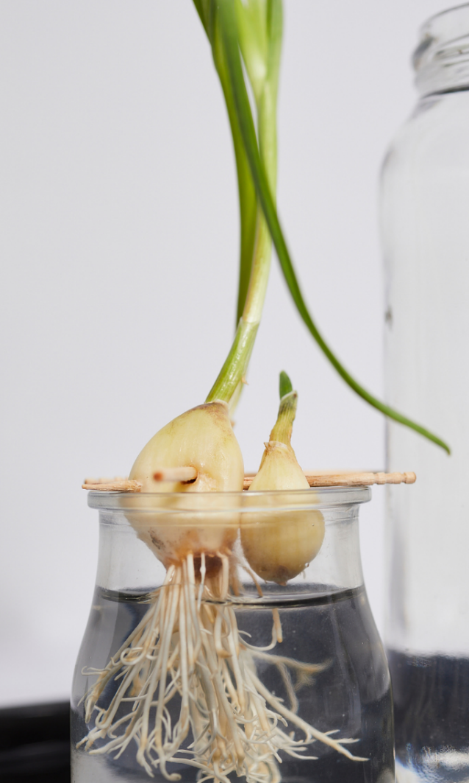
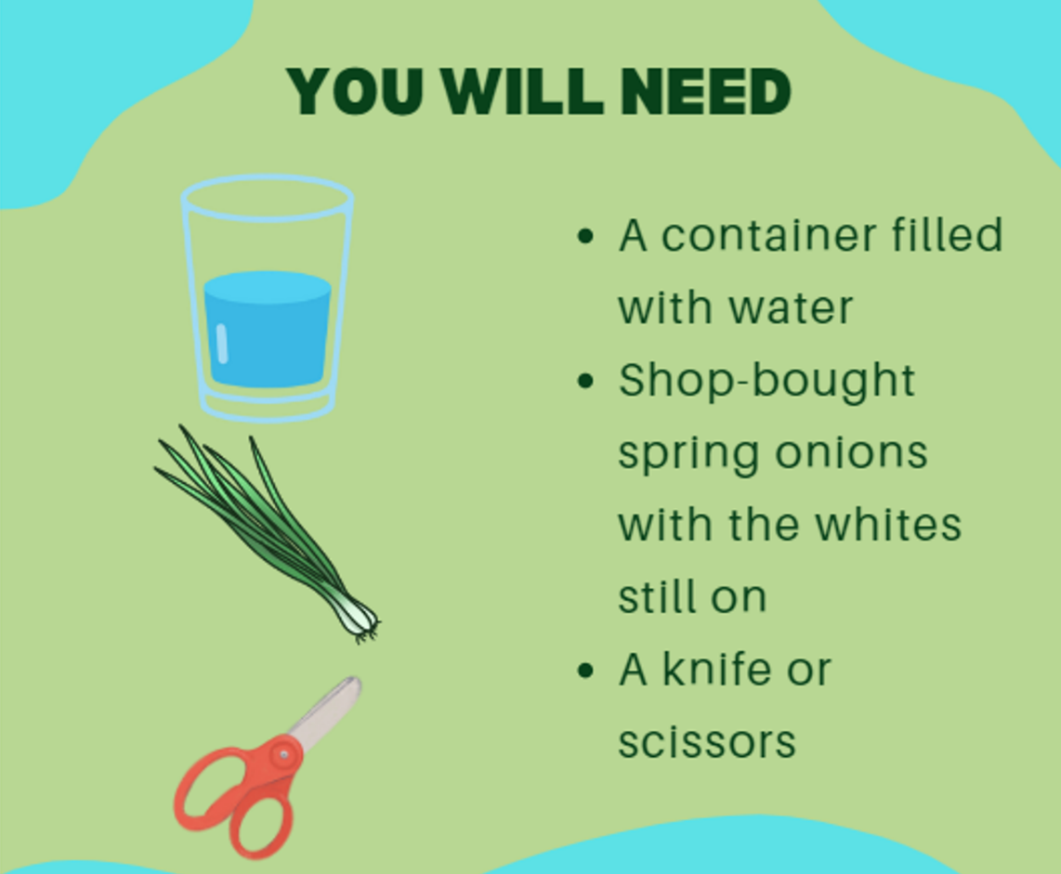
You will need:

Slide 11
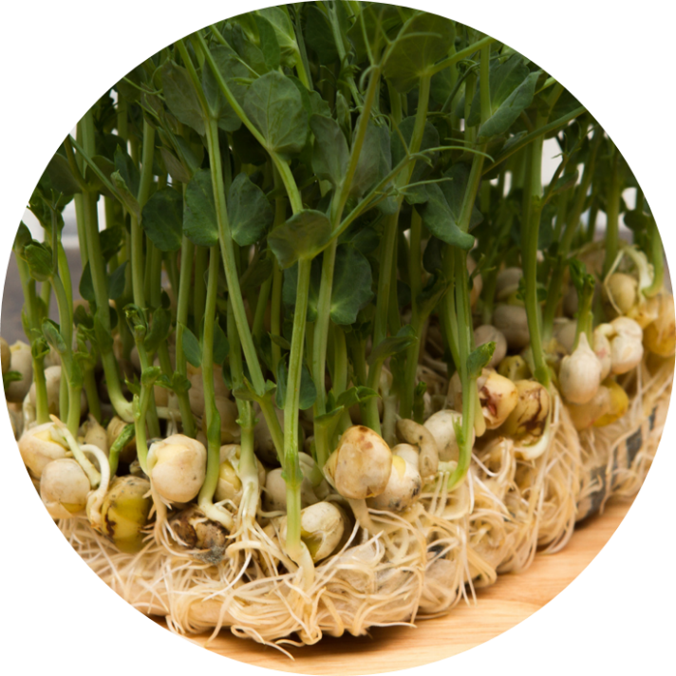
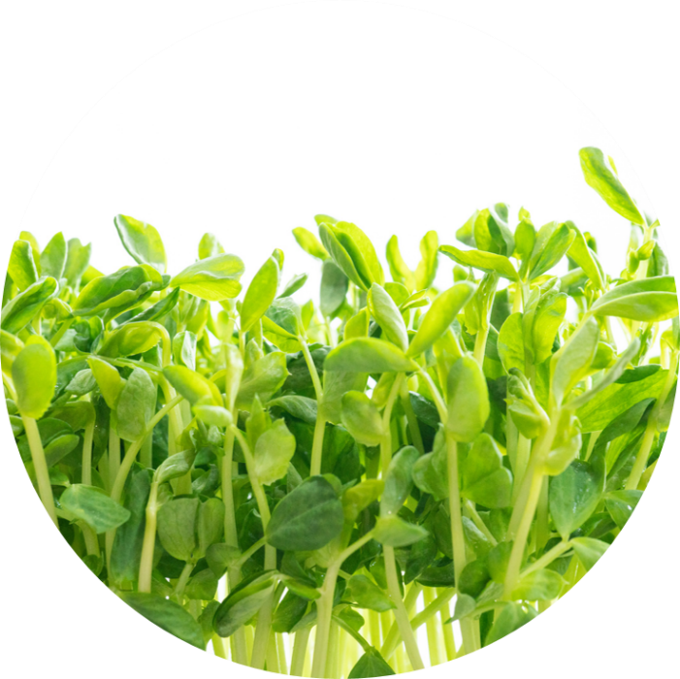
Grow Speedy Pea Shoots
Fill a small pot/recycled container (with drainage holes) 3/4 full with peat-free compost.
Sprinkle 8-10 peas on top.
Cover with roughly 2cm of compost, water well & place in a sunny spot. Keep soil moist.
After a few days, green shoots will begin to appear. In about 15-30 days your pea shoots will be ready to eat!
Cut above the first leaf to harvest and the plant will regrow!

Slide 12
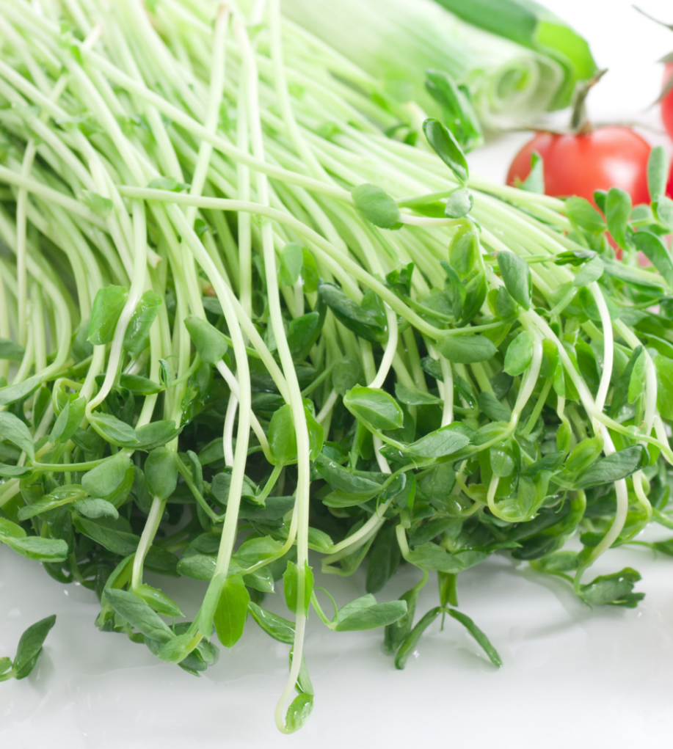
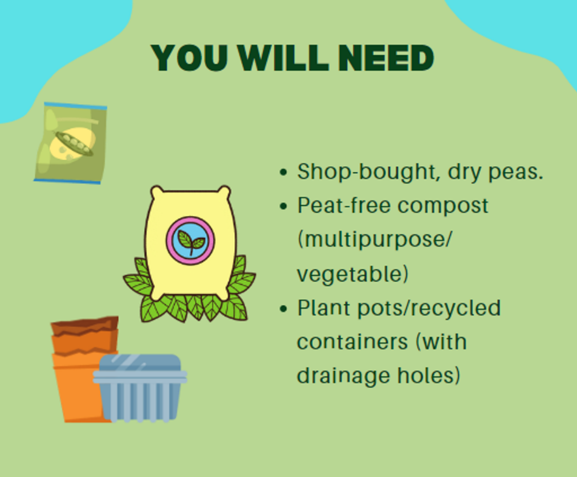
You will need:

Slide 13
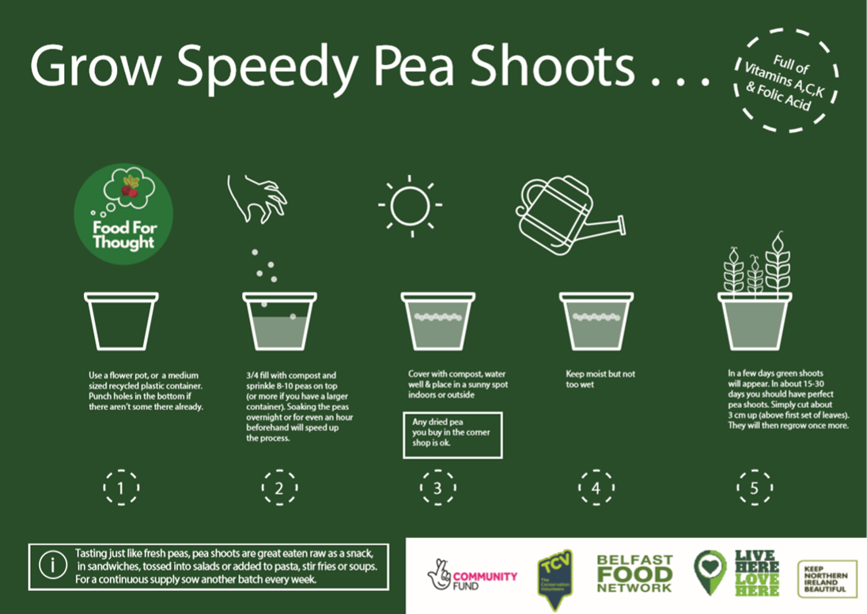

Slide 14
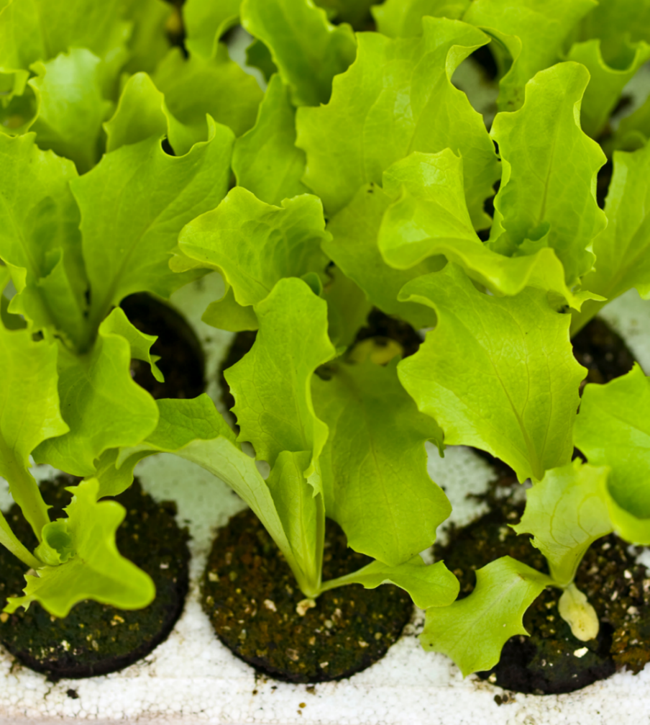
Salad Leaves
Fill a small pot (with drainage holes) 3/4 full with peat-free compost.
Sow a thin layer of seeds and cover with roughly 1cm of compost.
Water well and place on a sunny windowsill.
Water when the soil is dry to the touch.
Your salad leaves will be ready to harvest in 5-8 weeks!
https://ccea.org.uk/growing/march.php

Slide 15
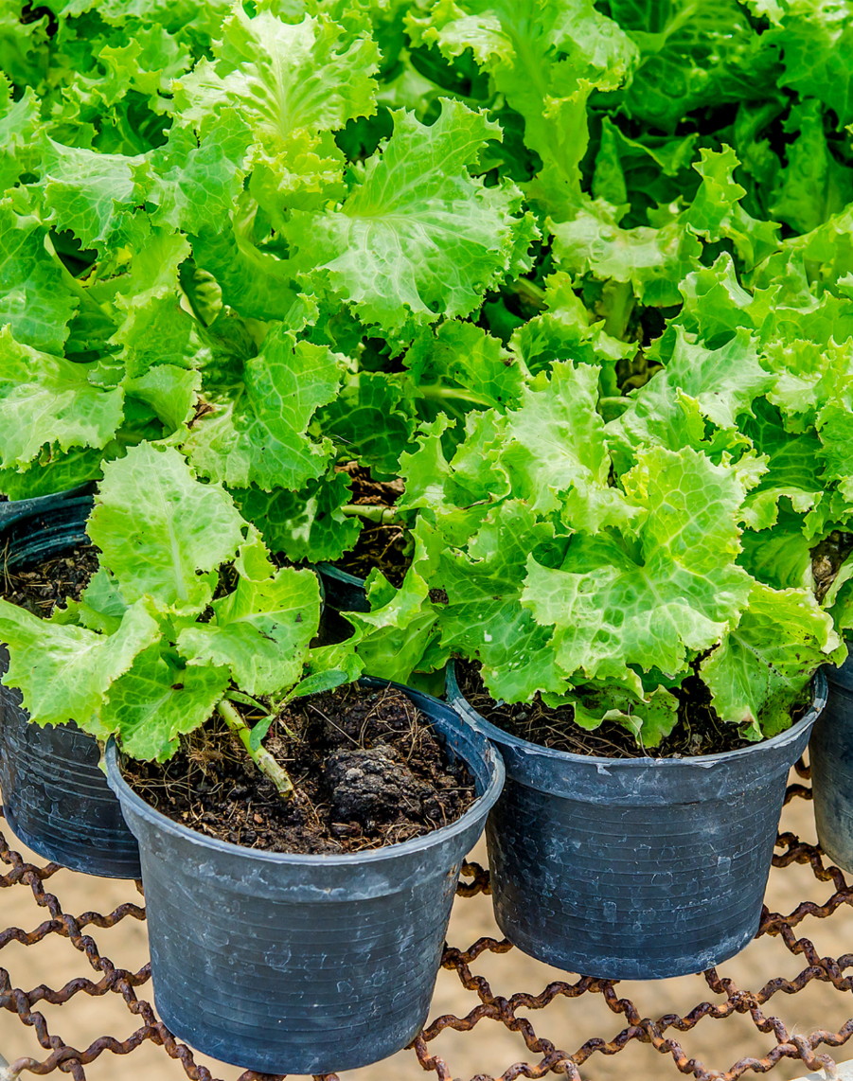
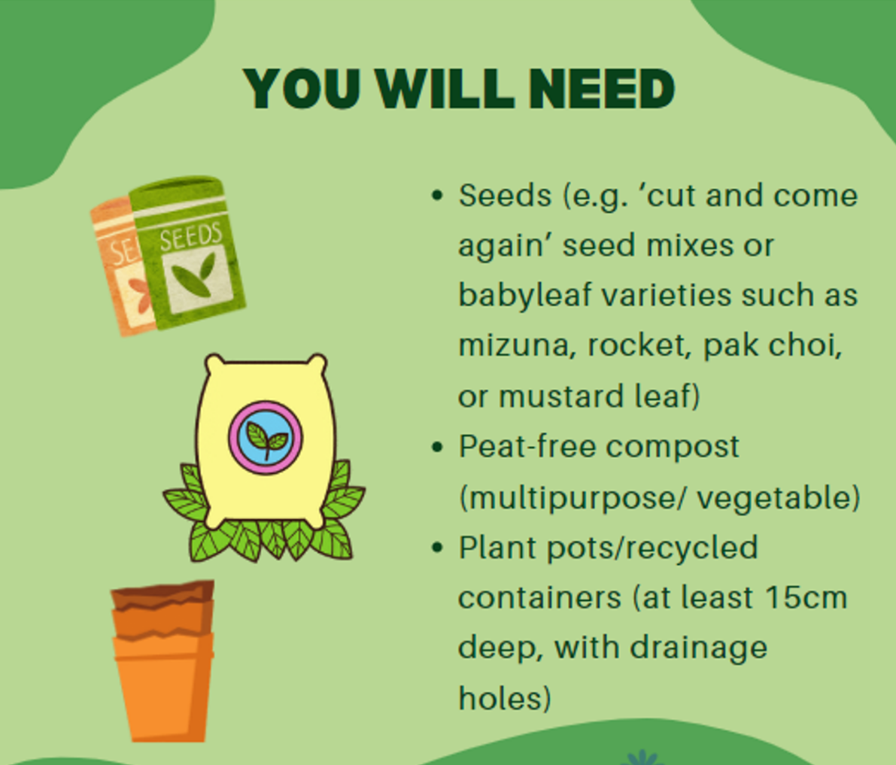
You will need:

Slide 16
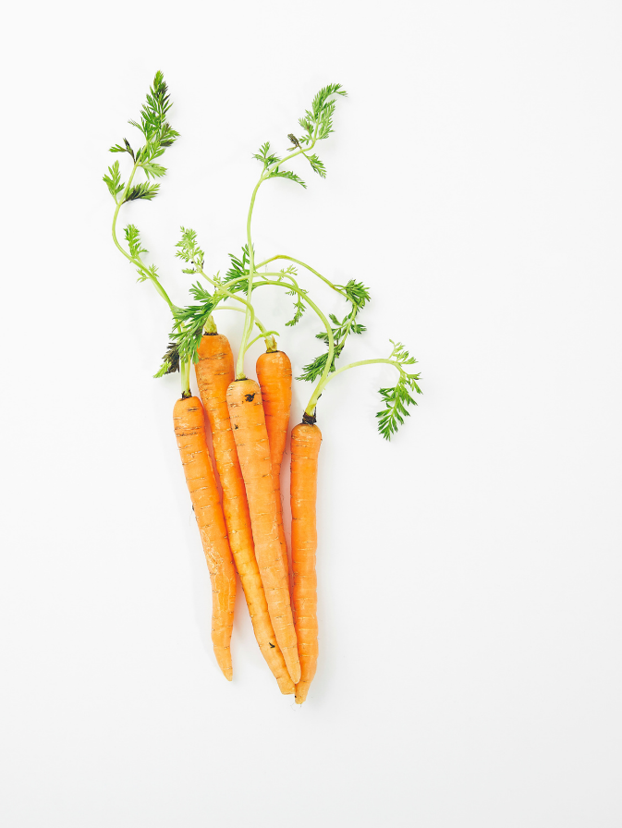
Baby Carrots
Fill a large container (make sure it has drainage holes) 3/4 full with peat-free multipurpose/vegetable compost.
Sow fast growing varieties of carrot (e.g. Early Nates) over the surface and lightly cover with soil.
Water well and place in a sunny spot. Water when soil is dry.
After roughly 60 days, your carrots are ready to harvest!

Slide 17
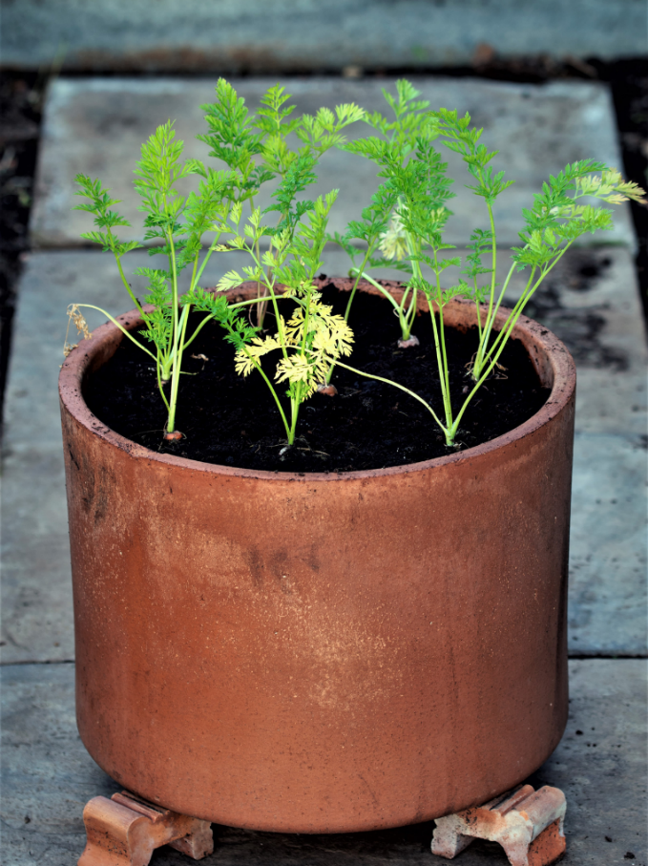
You will need:

