Slide 1
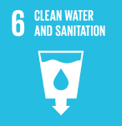
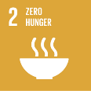
Water is Life
Water
Climate Change
Biodiversity
Healthy
Living
Global
Perspective
Energy

Slide 2
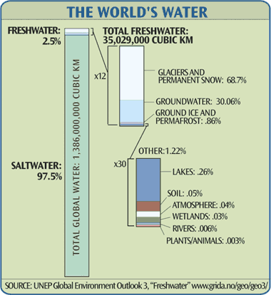
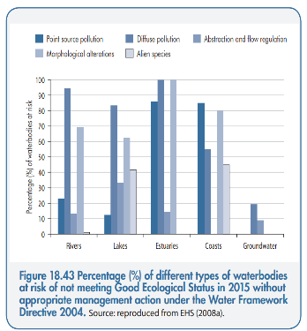
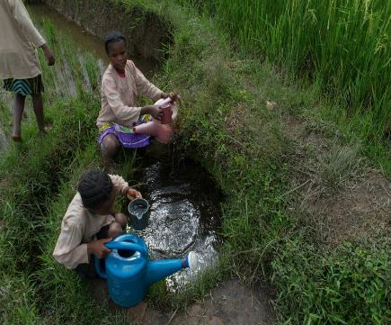
Freshwater is Rare Clean water is even more rare

Slide 3
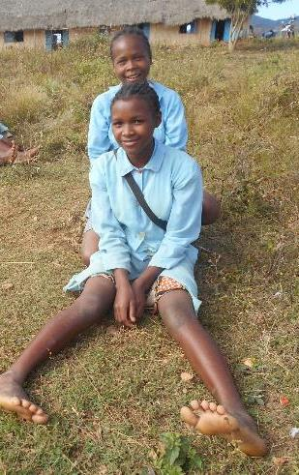
Water is YOU

Slide 4
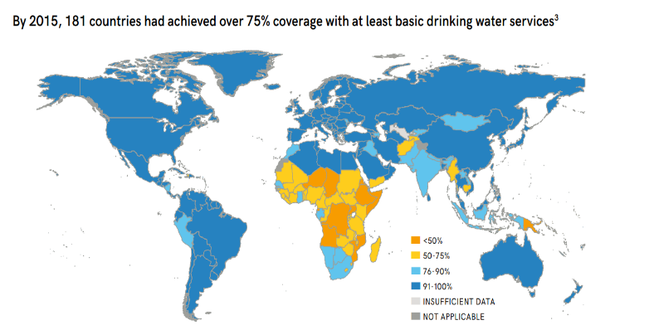
Access to Safe Drinking Water
JMP-2017-tr-safely managed drinking water services.pdf

Slide 5
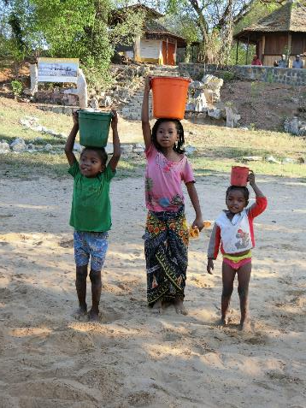
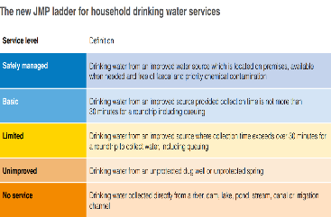
Access to Drinking Water – Madagascar (% of population, 2000 and 2015)
 | At Least Basic | Limited (>30 min) | Un-improved | Surface Water
2000 All | 37 | 2 | 21 | 41
2015 All | 51 | 3 | 31 | 16
2000 Rural | 25 | 1 | 24 | 50
2015 Rural | 34 | 2 | 41 | 23
2000 Urban | 69 | 3 | 12 | 15
2015 Urban | 82 | 4 | 12 | 2
JMP-2017-tr-safely managed drinking water services.pdf

Slide 6
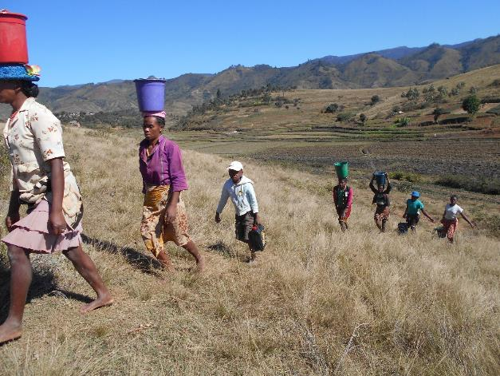
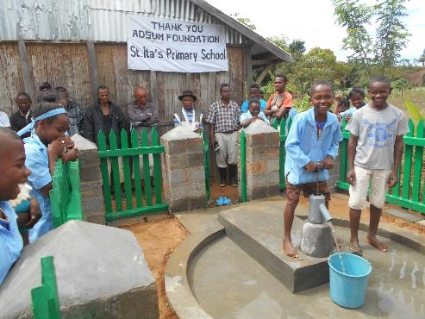
Water is for Drinking - Madagascar

Slide 7
Recent UN Action in Madagascar
More than 139,000 people have gained access to safe water through the establishment of 104 new boreholes, 183m³ of trucked water and 550 water points rehabilitated by UNICEF, Government and partners. UNICEF has continued to support the National Nutrition Office and Ministry of Health, including through the provision of 9,000 boxes of ready-to-use therapeutic food, therapeutic milk and essential drugs; and the extension of the severe acute malnutrition (SAM) surveillance system. To date, 7,000 families with children suffering from SAM have received a WASH kit and awareness raising on the use of the ceramic filter and handwashing with soap. 550 water points have been rehabilitated, benefiting an estimated 100,000 people with clean water, including at schools and health centres; 104 new boreholes have been drilled and equipped with hand pumps, benefiting 24,550 people; and 3 new mid-level water supply schemes have been completed, benefitting 5,270 people. The construction of 16 boreholes and 8 mid-level water supply systems remain in progress and will benefit an estimated additional 20,500 people with clean water.
OCHA – UN Office for Coordination of Humanitarian Affairs 2017

Slide 8
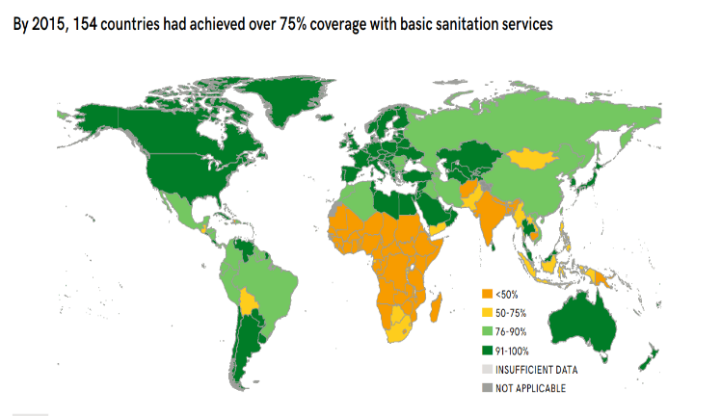
Access to Safe Sanitation WASHdata

Slide 9
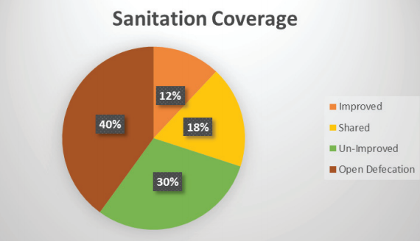
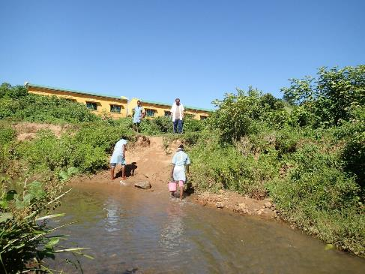
Access to Sanitation in Madagascar (2015)
 | At Least Basic | Limited (shared) | Unim- proved | Open Defecation
National (Yr 2015) | 10 | 14 | 32 | 44
Rural (2015) | 6 | 9 | 29 | 55
Urban (2015) | 16 | 24 | 37 | 23
National (Yr 2000) | 5 | 7 | 51 | 38
JMP-2017-tr-safely managed drinking water services.pdf

Slide 10
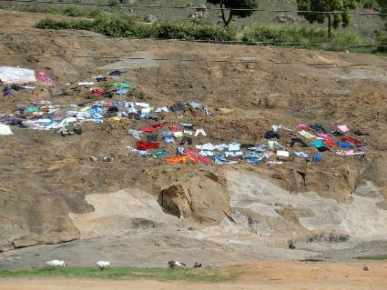
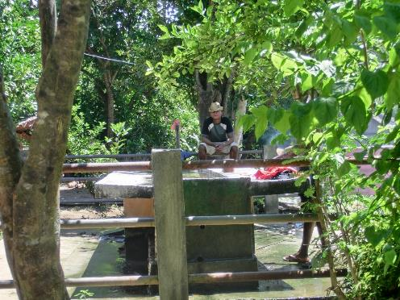
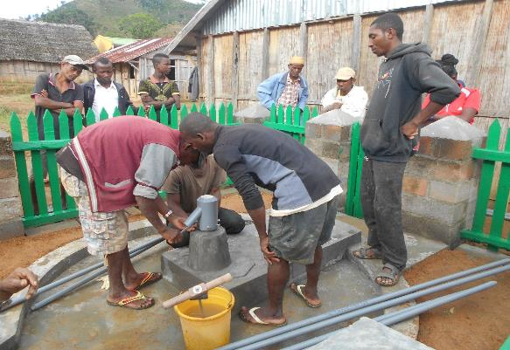
Water is for Health

Slide 11
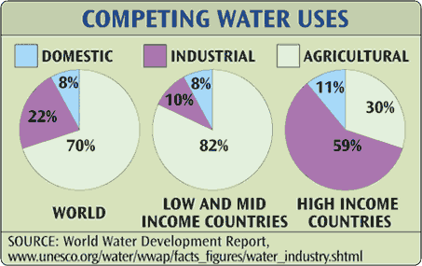
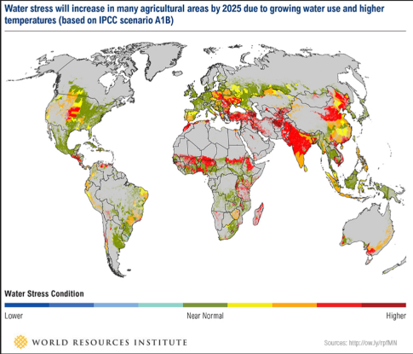
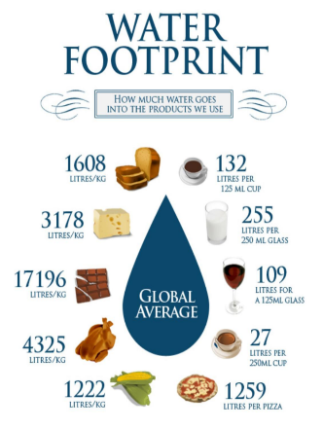
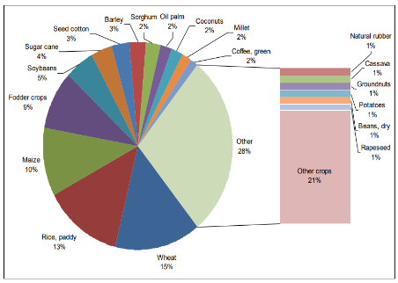
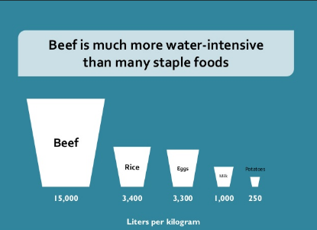
Water is Food
Contribution of different crops to the total water footprint of global crop production (1996-2005)
http://wfn.project-platforms.com/Reports/Report47-WaterFootprintCrops-Vol1.pdf

Slide 12
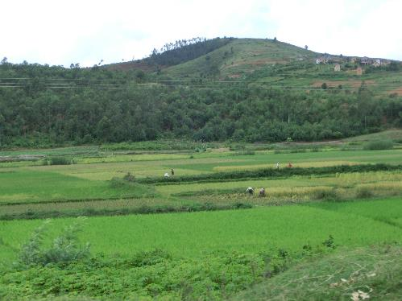
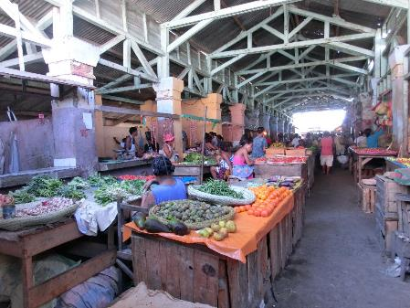
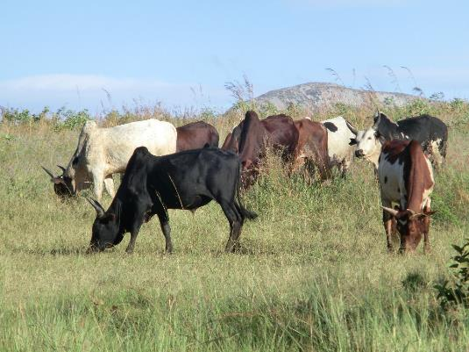
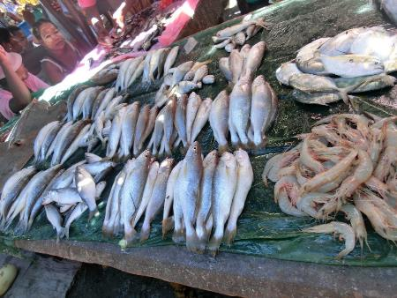
Water is Food

Slide 13
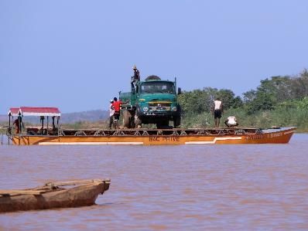
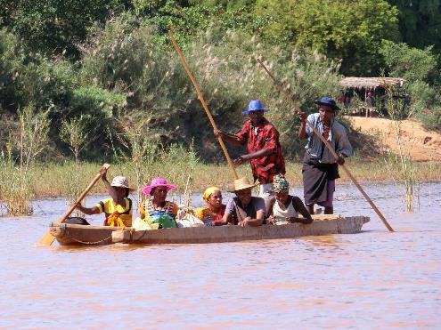
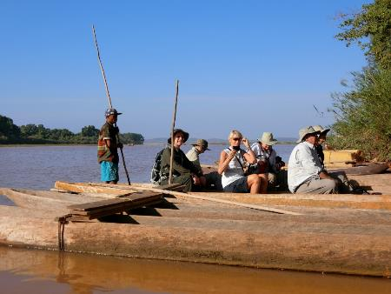
Water is Transport, Tourism, Recreation and Leisure

Slide 14
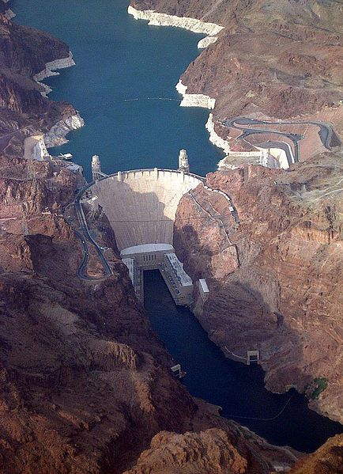
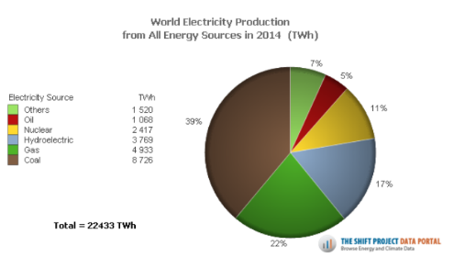
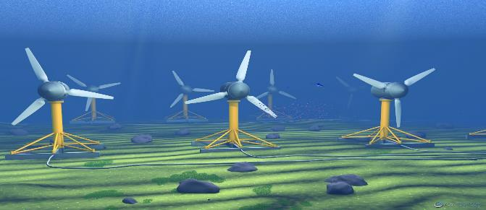
Water is Power

Slide 15
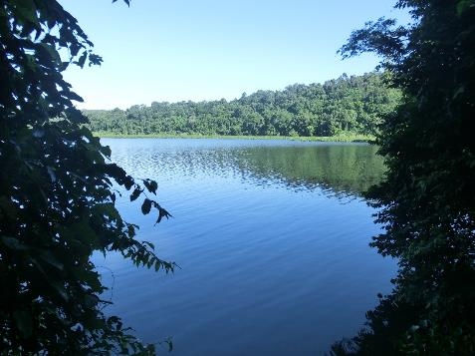
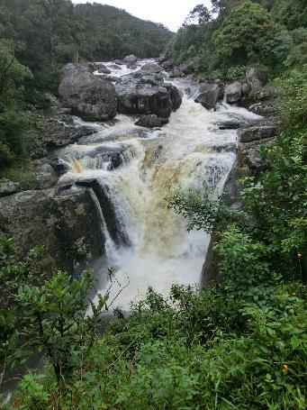
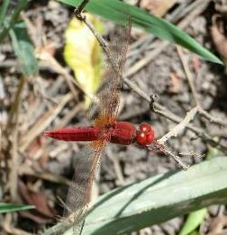
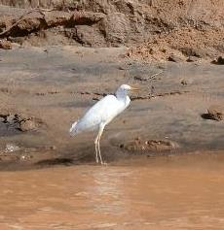
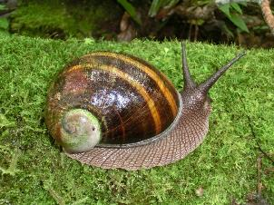
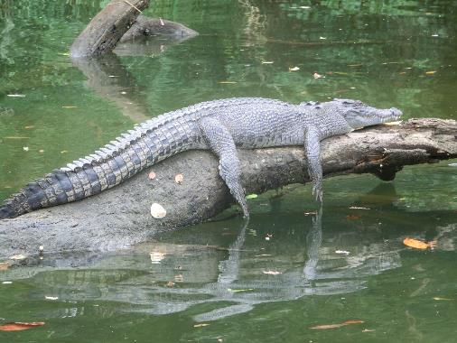
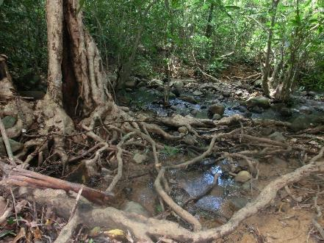
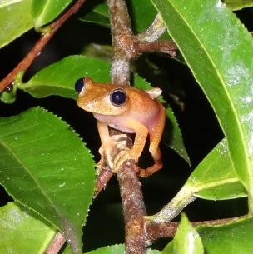
Water is Biodiversity

Slide 16
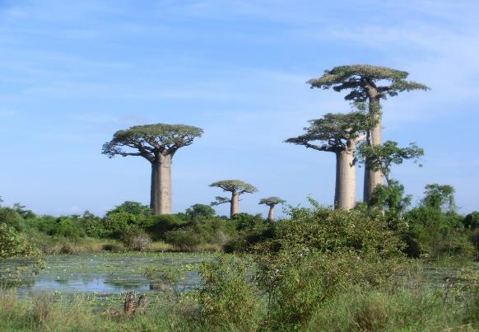
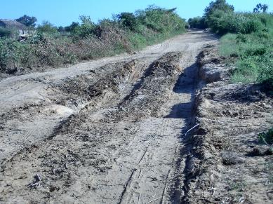
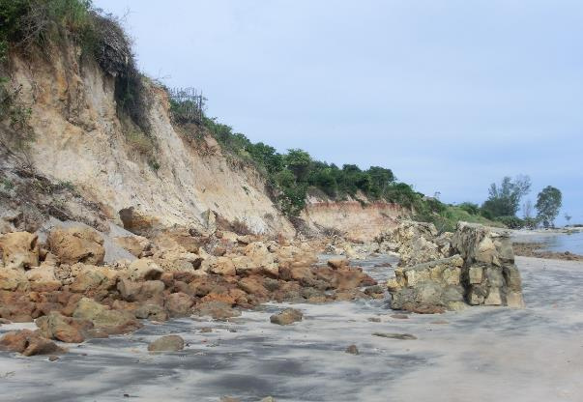
Water is Seasonal and Destructive

Slide 17
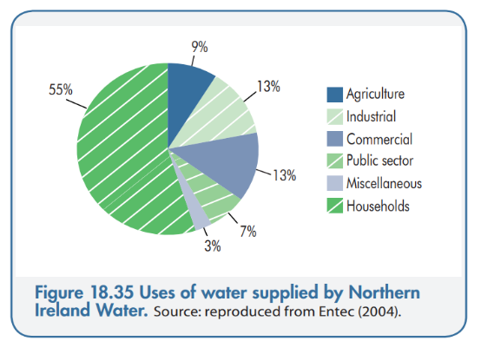
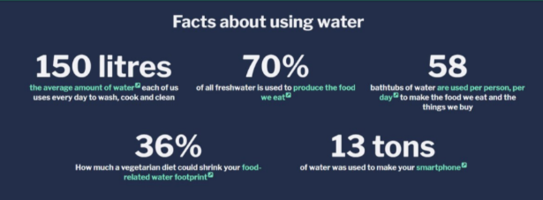
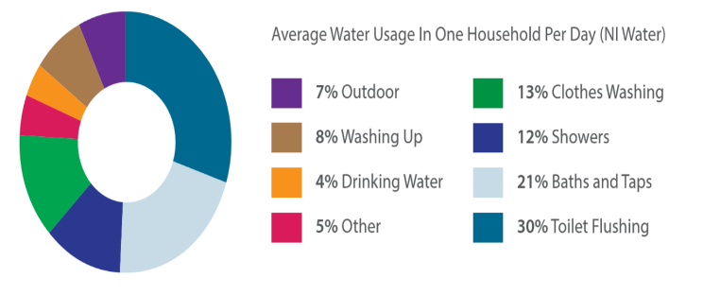
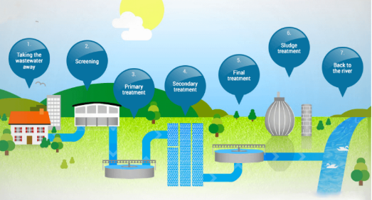
Water in Northern Ireland

Slide 18
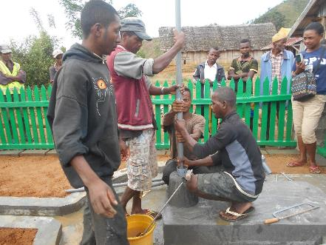
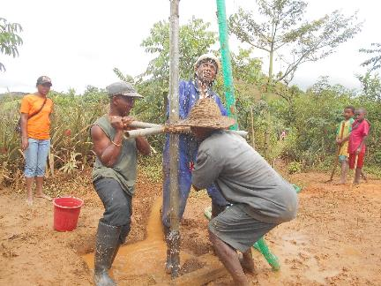
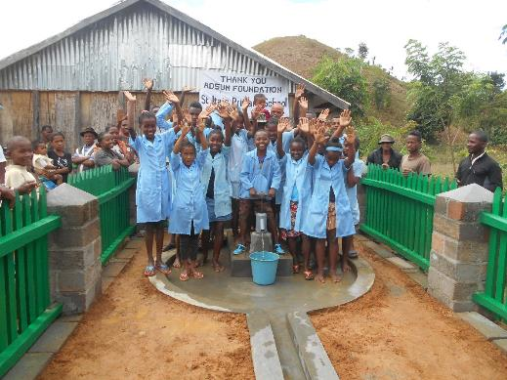
Tanakambana Secondary School

Slide 19
Ambalamanenjana Primary
School

